Slide 1
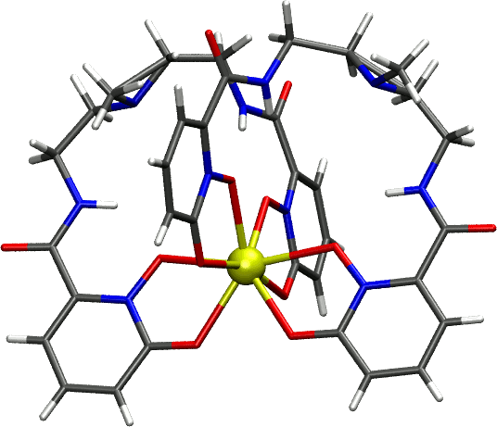
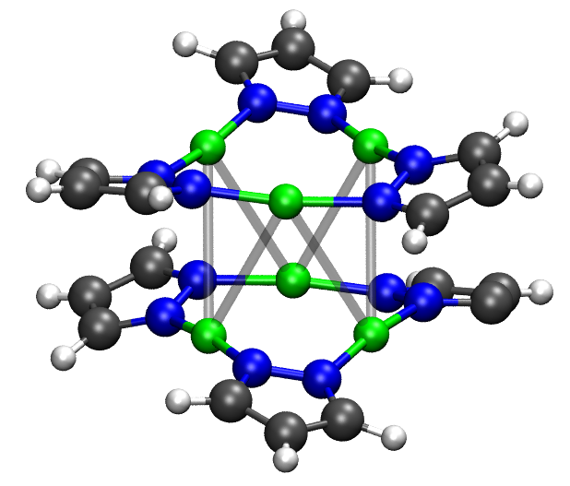
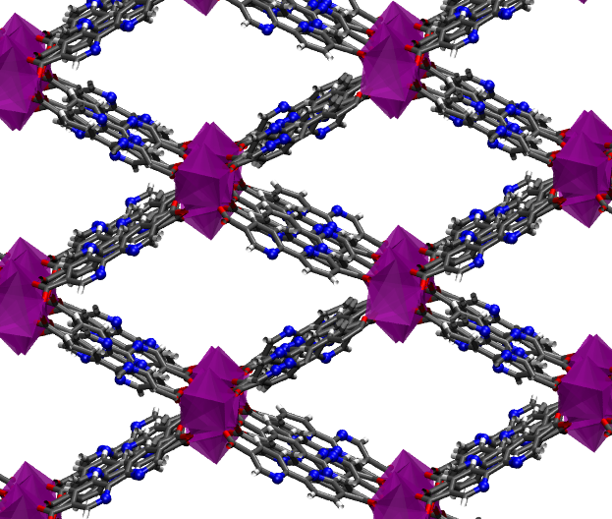
System Size
Spin-Crossover Complexes
Single Molecule Magnets
Organoactinide Systems
Gd MRI Contrast Agents
Ln photosensors
Metal Clusters
Bimetallic SMMs
Bimetallic catalysts
Model Enzyme active sites
Luminescent MOFs
Photocatalytic MOFs
MOFs as Sensors

Slide 2
System Size
Spin-Crossover Complexes
Single Molecule Magnets
Organoactinide Systems
Gd MRI Contrast Agents
Ln photosensors
Metal Clusters
Bimetallic SMMs
Bimetallic catalysts
Model Enzyme active sites
Luminescent MOFs
Photocatalytic MOFs
MOFs as Sensors
Nanowires
Molecules on Surfaces
Defect Sites

Slide 3
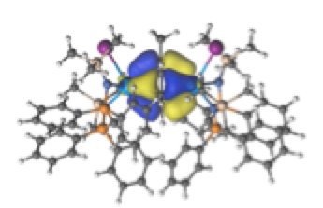
U-X
U-X-U
U-X-U
= N, P, and O donating ligands
X = arenes, N, O
= N, P, and O donating ligands
X = arenes, N, O, and functionalized arenes
All molecules:
DFT Geometry optimizations
Molecules where lowest energy states with DFT are within 3 kcal/mol:
CASSCF/CASPT2
Molecules where lowest energy states with CASPT2 are within 3 kcal/mol:
Relativistic CASSCF/CASPT2 or SO-CASPT2

Slide 4
Hartree Fock
CASSCF
Empty
(Virtual)
Active
Occupied
(Inactive)

Slide 5
